Slide 1
Decision Trees
Programming Assignment 1
Team: Atharva Tere (agtere@iu.edu) and Jivitesh Poojary(jpoojary@iu.edu)

Slide 2
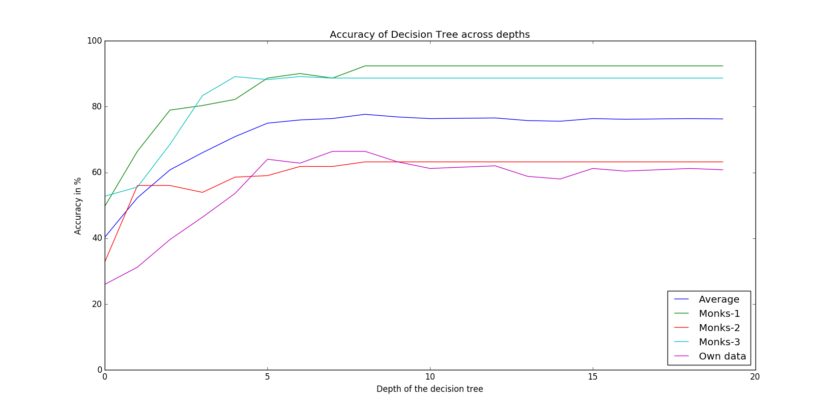
Accuracy Curve

Slide 3
Depth 1: Train on Monks-1 and Test on Monks-1
A5
Accuracy: 66.435%
>=2
<2
Confusion Metrix:
1
0
 | Observed=0 | Observed=1
Predicted=0 | 144 | 72
Predicted=1 | 73 | 143

Slide 4
Depth 2: Train on Monks-1 and Test on Monks-1
A5
Accuracy: 78.935%
>=2
<2
Confusion Metrix:
A1
1
 | Observed=0 | Observed=1
Predicted=0 | 168 | 42
Predicted=1 | 49 | 173
>=3
<3
1
0

Slide 5
Depth 1: Train on Monks-2 and Test on Monks-2
A4
Accuracy: 56.018%
>=2
<2
Confusion Metrix:
1
0
 | Observed=0 | Observed=1
Predicted=0 | 176 | 76
Predicted=1 | 114 | 66

Slide 6
Depth 2: Train on Monks-2 and Test on Monks-2
A4
Accuracy: 56.0185%
>=2
<2
Confusion Metrix:
A5
A5
 | Observed=0 | Observed=1
Predicted=0 | 180 | 80
Predicted=1 | 110 | 62
>=2
<2
>=4
<4
1
0
1
0

Slide 7
Depth 1: Train on Monks-3 and Test on Monks-3
A2
Accuracy: 55.56%
>=3
<3
Confusion Metrix:
1
0
 | Observed=0 | Observed=1
Predicted=0 | 162 | 150
Predicted=1 | 42 | 78

Slide 8
Depth 2: Train on Monks-3 and Test on Monks-3
A2
Accuracy: 68.518%
>=3
<3
Confusion Metrix:
A5
A4
 | Observed=0 | Observed=1
Predicted=0 | 184 | 116
Predicted=1 | 20 | 112
>=4
<4
>=2
<2
1
0
1
0

Slide 9
Depth 1: Train and test on own dataset
CA
Accuracy: 31.2%
>=7980
<7980
Confusion Metrix:
1
0
 | Observed=0 | Observed=1
Predicted=0 | 31 | 18
Predicted=1 | 154 | 47
*CA = CreditAmount

Slide 10
Depth 2: Train and test on own dataset
CA
Accuracy: 39.6%
>=7980
<7980
Confusion Metrix:
DM
A
 | Observed=0 | Observed=1
Predicted=0 | 43 | 9
Predicted=1 | 142 | 56
>=45
<45
>=30
<30
1
0
1
0
*CA => CreditAmount
DM => DurationMonths
A => Age

Slide 11
Best case performance for all trees in python
Monks 1
Best accuracy = 92.7%
Optimal Depth = 8
Monks 2
Best accuracy = 63.194
Own Data
TP = 61
Monks 3
TP = 192
TN = 207
FP = 10
FN = 23
Optimal Depth = 8
TN = 212
FP = 78
FN = 81
Best Accuracy = 89.12%
Optimal Depth = 4
TP = 796
TN = 189
FP = 15
FN = 32
Best Accuracy = 66.4%
Optimal Depth = 7/8
TP = 25/29
TN = 140/136
FP = 45/49
FN = 40/36
Since 2 different depths give the same accuracy for the German dataset (own data), we can choose the optimum values based on the cost of TP, FP, TN and FN.
Since in loan predictions, FP is costlier than FN (FP:FN=5:1), we should choose depth 7

Slide 12
Weka – Train on Monks-1 and Test on Monks-1
Accuracy: 100% (Pruned)
Confusion Matrix:
Decision tree made by
Weka for Monks-1
training data
 | Observed=0 | Observed=1
Predicted=0 | 216 | 0
Predicted=1 | 0 | 216
Decision tree made by
Weka for Monks-1
training data
(image)
If you can’t see the embedded files, same are available in the zip file

Slide 13
Weka – Train on Monks-2 and Test on Monks-2
Accuracy: 80.5556% (Pruned)
Confusion Matrix:
Decision tree made by
Weka for Monks-2
training data
 | Observed=0 | Observed=1
Predicted=0 | 258 | 32
Predicted=1 | 52 | 90
Decision tree made by
Weka for Monks-2
training data
(image)
If you can’t see the embedded files, same are available in the zip file

Slide 14
Weka – Train on Monks-3 and Test on Monks-3
Accuracy: 95.3704% (Pruned)
Confusion Matrix:
Decision tree made by
Weka for Monks-2
training data
 | Observed=0 | Observed=1
Predicted=0 | 220 | 8
Predicted=1 | 12 | 192
Decision tree made by
Weka for Monks-2
training data
(image)
If you can’t see the embedded files, same are available in the zip file

Slide 15
Weka – Train and Test on own data set
Accuracy: 95.3704% (Pruned)
Confusion Matrix:
Decision tree made by
Weka for Monks-2
training data
 | Observed=0 | Observed=1
Predicted=0 | 160 | 25
Predicted=1 | 43 | 22
Decision tree made by
Weka for Monks-2
training data
(image)
If you can’t see the embedded files, same are available in the zip file

